Slide 1


Chapter 6: Static Routing
Routing Protocols
Notes:
Cisco Networking Academy program
Routing Protocols
Chapter 6: Static Routing

Slide 2
Static Routing Reach Remote Networks
A router can learn about remote networks in one of two ways:
Manually - Remote networks are manually entered into the route table using static routes.
Dynamically - Remote routes are automatically learned using a dynamic routing protocol.
Notes:
6.1.1.1

Slide 3
Static Routing Why Use Static Routing?
Static routing provides some advantages over dynamic routing, including:
Static routes are not advertised over the network, resulting in better security.
Static routes use less bandwidth than dynamic routing protocols, no CPU cycles are used to calculate and communicate routes.
The path a static route uses to send data is known by the administrator as its explicitly setup.
Notes:
6.1.1.2

Slide 4
Static Routing Why Use Static Routing? (continued)
Static routing has the following disadvantages:
Initial configuration and maintenance is time-consuming.
Configuration is error-prone, especially in large networks.
Administrator intervention is required to maintain changing route information.
Does not scale well with growing networks; maintenance becomes cumbersome.
Requires complete knowledge of the whole network for proper implementation.
Notes:
6.1.1.2

Slide 5
Static Routing When to Use Static Routes
Static routing has three primary uses:
Providing ease of routing table maintenance in smaller networks that are not expected to grow significantly.
Routing to and from stub networks. A stub network is a network accessed by a single route, and the router has no other neighbors.
Using a single default route to represent a path to any network that does not have a more specific match with another route in the routing table. Default routes are used to send traffic to any destination beyond the next upstream router.
A default static route is a route that matches all packets.
A default route identifies the gateway IP address to which the router sends all IP packets that it does not have a learned or static route.
A default static route is simply a static route with 0.0.0.0/0 as the destination IPv4 address.
Notes:
6.1.1.3

Slide 6
Types of Static Routes Static Route Applications
Static Routes are often used to:
Connect to a specific network
Provide a Gateway of Last Resort for a stub network
Reduce the number of routes advertised by summarizing several contiguous networks as one static route
Create a backup route in case a primary (dynamic) route link fails
Notes:
6.1.2.1

Slide 7
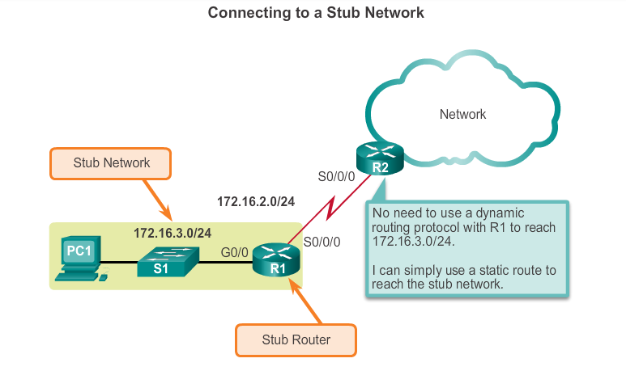
Types of Static Routes Standard Static Route
Notes:
6.1.2.2

Slide 8
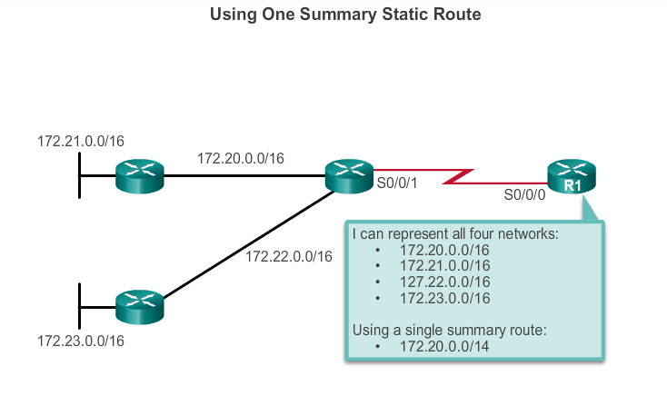
Types of Static Routes Summary Static Route
Notes:
6.1.2.4

Slide 9
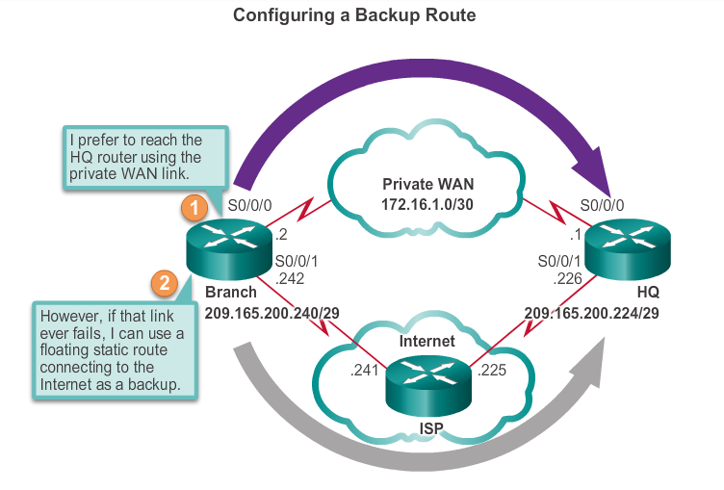
Types of Static Routes Floating Static Route
Floating static routes are static routes that are used to provide a backup path to a primary static or dynamic route, in the event of a link failure.
The floating static route is only used when the primary route is not available.
In order to accomplish this, the floating static route is configured with a higher administrative distance than the primary route.
Notes:
6.1.2.5

Slide 10
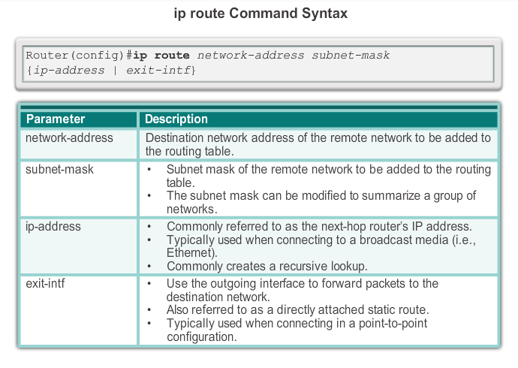
Configure IPv4 Static Routes ip route Command
Notes:
6.2.1.1

Slide 11
Configure IPv4 Static Routes Next-Hop Options
The next hop can be identified by an IP address, exit interface, or both. How the destination is specified creates one of the three following route types:
Next-hop route - Only the next-hop IP address is specified.
Directly connected static route - Only the router exit interface is specified.
Fully specified static route - The next-hop IP address and exit interface are specified.
Notes:
6.2.1.2

Slide 12
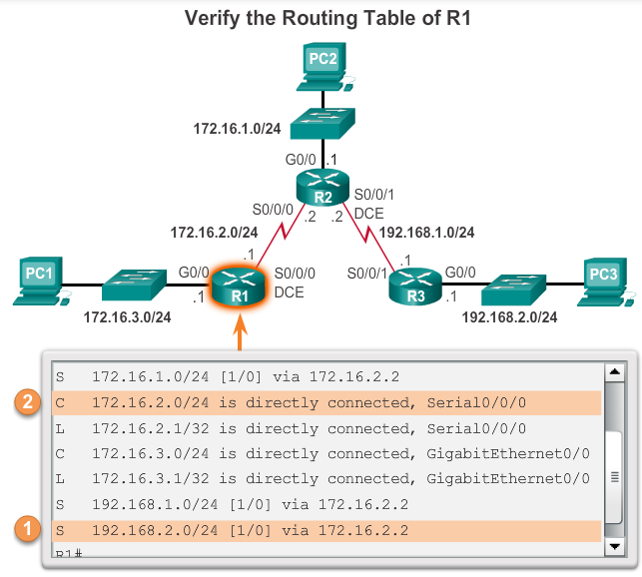
Configure IPv4 Static Routes Configure a Next-Hop Static Route
When a packet is destined for the 192.168.2.0/24 network, R1:
1. Looks for a match in the routing table and finds that it has to forward the packets to the next-hop IPv4 address 172.16.2.2.
2. R1 must now determine how to reach 172.16.2.2; therefore, it searches a second time for a 172.16.2.2 match.
Notes:
6.2.1.3

Slide 13

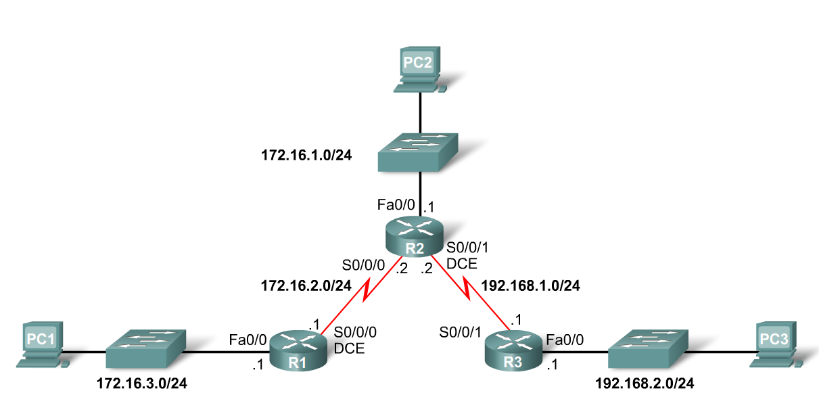
Static Routes Example
R1(config)#ip route 172.16.1.0 255.255.255.0 172.16.2.2
ip route - Static route command
172.16.1.0 – Destination network address
255.255.255.0 - Subnet mask of destination network
172.16.2.2 - Serial 0/0/0 interface IP address on R2, which is the "next-hop" to this network
Remote

Slide 14
Static Routes Example
R1(config)#ip route 172.16.1.0 255.255.255.0 Serial 0/0/0
ip route - Static route command
172.16.1.0 – Destination network address
255.255.255.0 - Subnet mask of destination network
Serial0/0/0 – Local Exit interface
Local

Slide 15
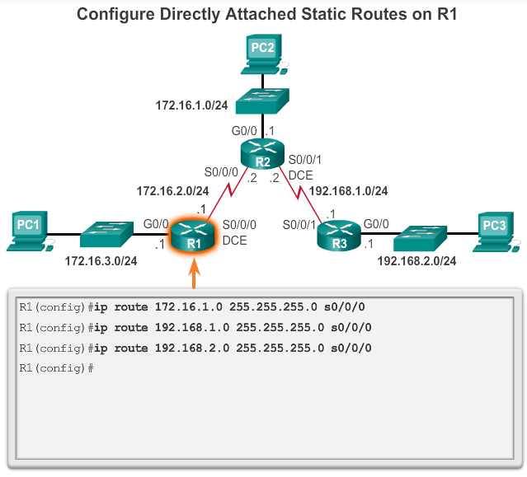
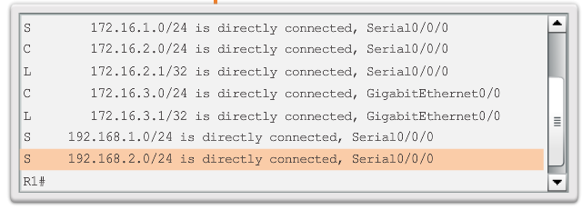
Configure IPv4 Static Routes Configure Directly Connected Static Route
Notes:
6.2.1.4

Slide 16
Configure IPv4 Static Routes Configure a Fully Specified Static Route
In a fully specified static route, both the local exit interface and the next-hop IP address are specified.
This is another type of static route that is used in older IOS’s, prior to CEF.
This form of static route is used when the output interface is a multi-access interface and it is necessary to explicitly identify the next hop.
The next hop must be directly connected to the specified exit interface.
Notes:
6.2.1.5

Slide 17
Configure IPv4 Static Routes Verify a Static Route
Along with ping and traceroute, useful commands to verify static routes include:
show ip route
show ip route static
show ip route network
Notes:
6.2.1.6

Slide 18
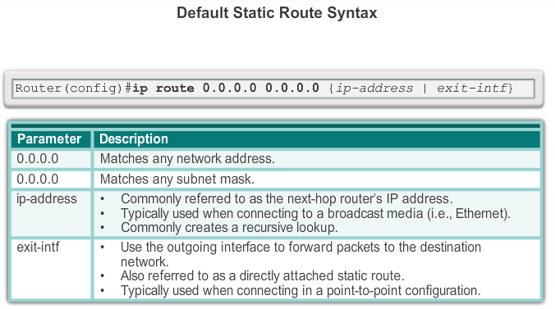
Configure IPv4 Default Routes Default Static Route
A default route is a static route that is used when there are no routes that have a specific match to the destination network.
This is a route that will match all packets. Stub routers that have a number of static routes all exiting the same interface are good candidates for a default route.
Notes:
6.2.2.1

Slide 19
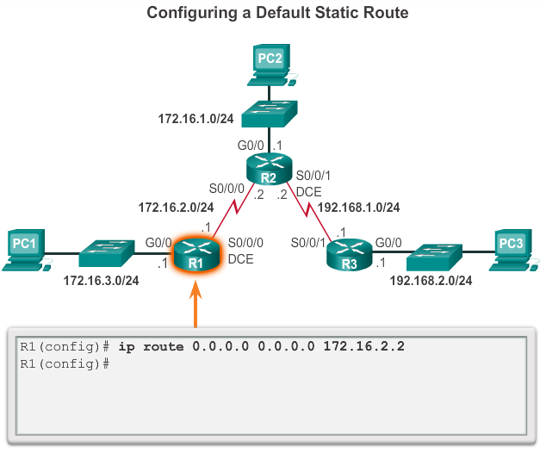
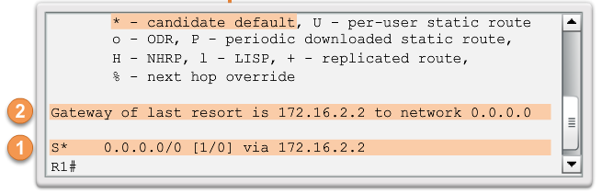
Configure IPv4 Default Routes Configure a Default Static Route
Notes:
6.2.2.2

Slide 20

Configure IPv6 Static Routes The ipv6 route Command
Most of parameters are identical to the IPv4 version of the command. IPv6 static routes can also be implemented as:
Standard IPv6 static route
Default IPv6 static route
Summary IPv6 static route
Floating IPv6 static route
Notes:
6.2.3.1

Slide 21
Configure IPv6 Static Routes Next-Hop Options
The next hop can be identified by an IPv6 address, exit interface, or both. How the destination is specified creates one of three route types:
Next-hop IPv6 route - Only the next-hop IPv6 address is specified.
Directly connected static IPv6 route - Only the router exit interface is specified.
Fully specified static IPv6 route - The next-hop IPv6 address and exit interface are specified.
Notes:
6.2.3.2

Slide 22
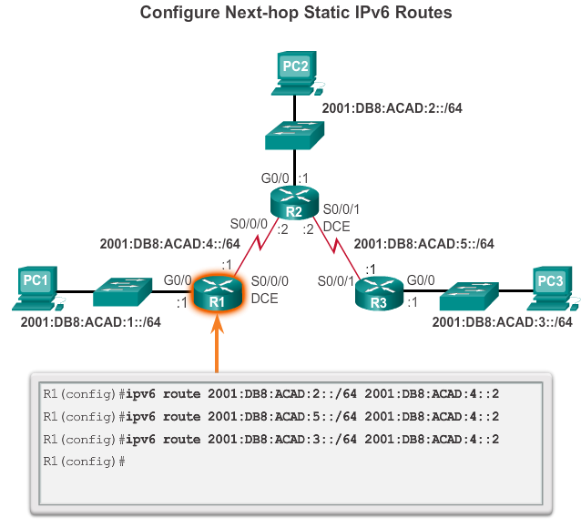
Configure IPv6 Static Routes Configure a Next-Hop Static IPv6 Route
Notes:
6.2.3.3

Slide 23
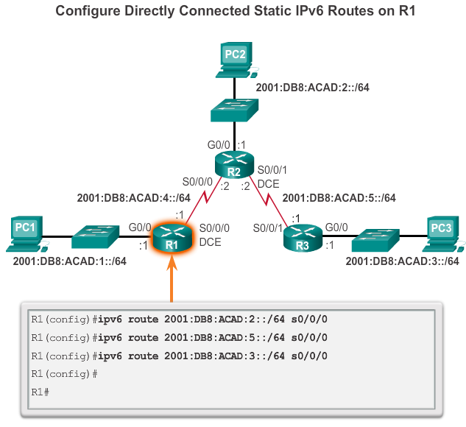
Configure IPv6 Static Routes Configure Directly connected Static IPv6 Route
Notes:
6.2.3.4

Slide 24
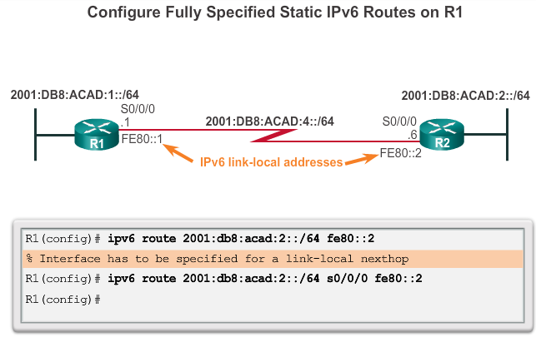
Configure IPv6 Static Routes Configure Fully Specified Static IPv6 Route
Notes:
6.2.3.5

Slide 25
Configure IPv6 Static Routes Verify IPv6 Static Routes
Along with ping and traceroute, useful commands to verify static routes include:
show ipv6 route
show ipv6 route static
show ipv6 route network
Notes:
6.2.3.6

Slide 26
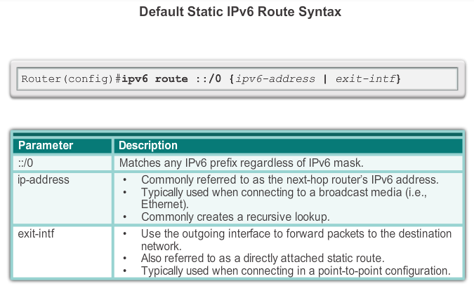
Configure IPv6 Default Routes Default Static IPv6 Route
Notes:
6.2.4.1

Slide 27
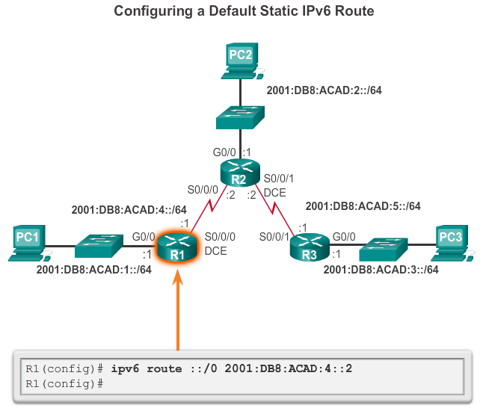
Configure IPv6 Default Routes Configure a Default Static IPv6 Route
Notes:
6.2.4.2

Slide 28
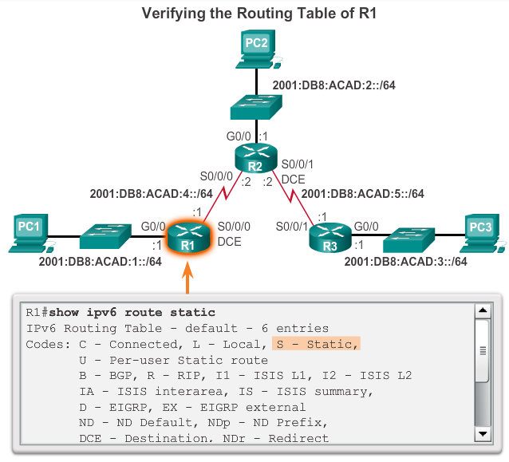
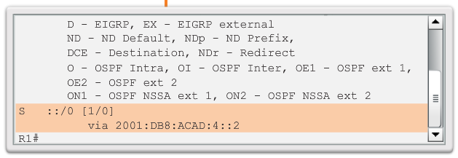
Configure IPv6 Default Routes Verify a Default Static Route
Notes:
6.2.4.3

Slide 29
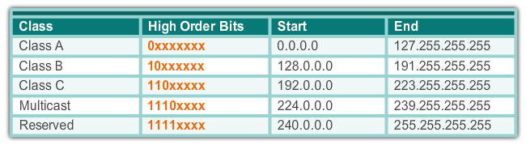
Classful Addressing Classful Network Addressing Re-cap
Notes:
6.3.1.1

Slide 30



Classful Addressing Classful Subnet Masks
Class A
Class B
Class C
Notes:
6.3.1.2

Slide 31
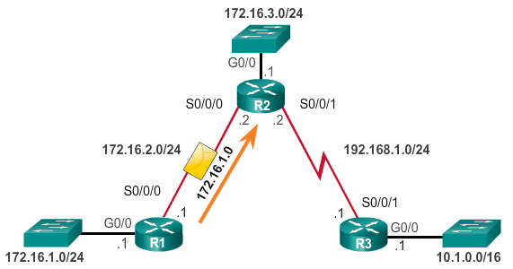
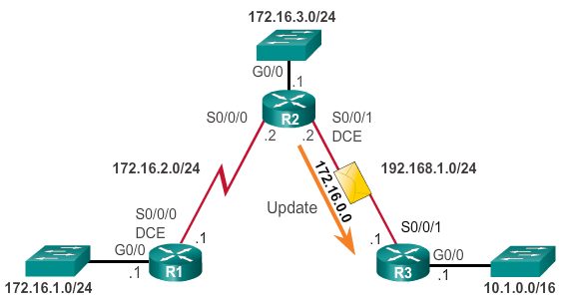
Classful Addressing Classful Routing Protocol Example
No subnet Mask Included in Updates
Notes:
6.3.1.3

Slide 32
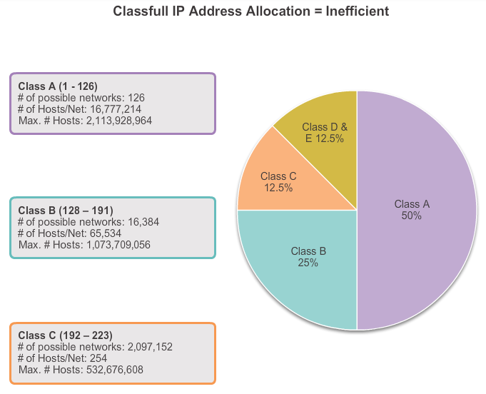
Classful Addressing Classful Addressing Waste
Notes:
6.3.1.4

Slide 33
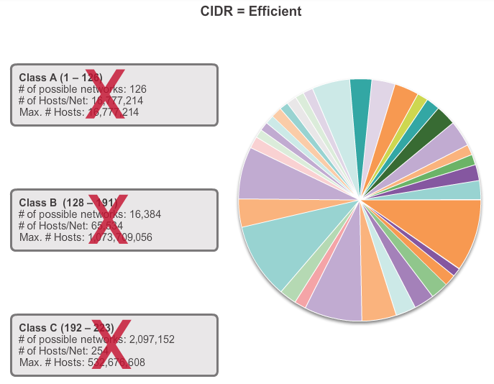
CIDR Classless Inter-Domain Routing
Notes:
6.3.2.1

Slide 34
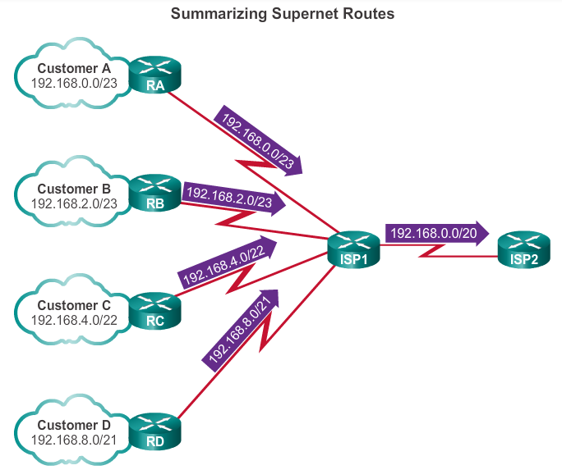
CIDR CIDR and Route Summarization
Summarizing routes reduces the size of the routing table.
A summary route is a single route that can be used to represent multiple routes.
Route summarization is the process of combining a number of static routes into a single static route.
Generally a set of contiguous networks.
Have the same exit interface or next-hop IP address.
Creates smaller routing tables
More efficient routing table lookup process.
Notes:
6.3.2.2

Slide 35

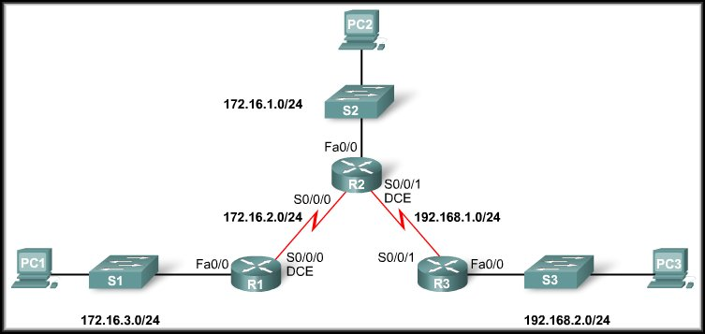
Summarizing routes
R3 has three static routes configured.
All three routes are forwarding traffic out the same Serial 0/0/1 interface.
Can be summarized to 172.16.0.0 / 22 (255.255.252.0)
R3(config)#ip route 172.16.0.0 255.255.252.0 192.168.1.2

Slide 36
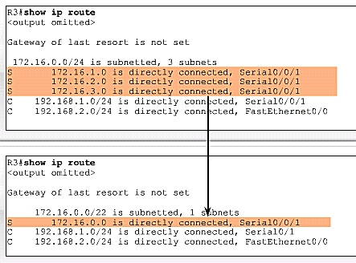
Effect of a Summary Route
Without
Summarizing
With
Summarizing.
Smaller Table = Quicker Lookup Process

Slide 37
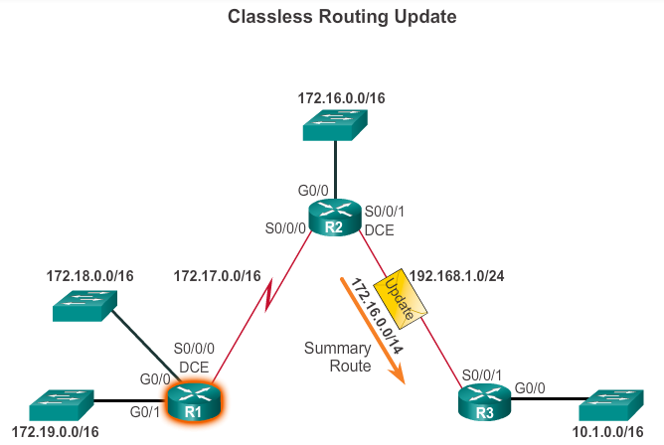
CIDR Classless Routing Protocol Example
Notes:
6.3.2.4

Slide 38
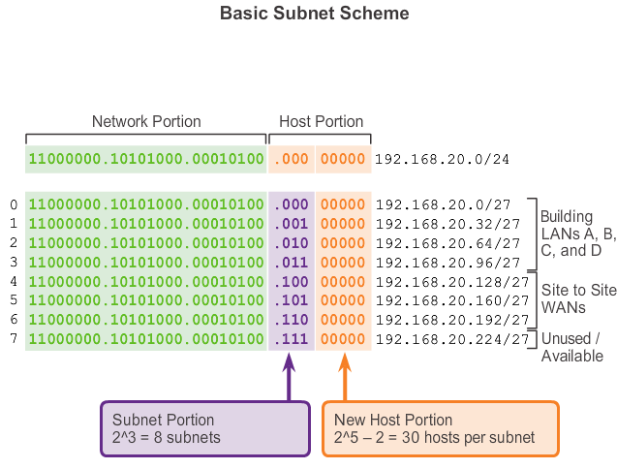
VLSM Fixed Length Subnet Masking
3 Borrowed bits
So new mask is /27 = 255.255.255.224
So Magic Number is: 256=224=32
So Network Addresses are 0, 32, 64, 96,128,….
3 Borrowed bits
Notes:
6.3.3.1

Slide 39
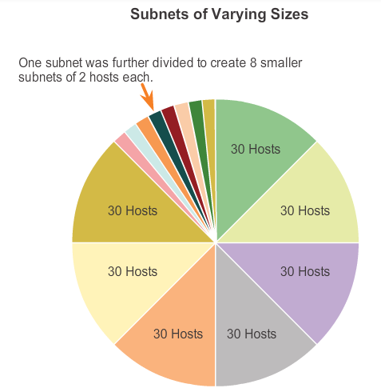
VLSM Variable Length Subnet Masking
Notes:
6.3.3.2

Slide 40
VLSM VLSM in Action
VLSM allows the use of different masks for each subnet.
After a network address is subnetted, those subnets can be further subnetted.
VLSM is simply subnetting a subnet. VLSM can be thought of as sub-subnetting.
Individual host addresses are assigned from the addresses of "sub-subnets".
Notes:
6.3.3.3

Slide 41
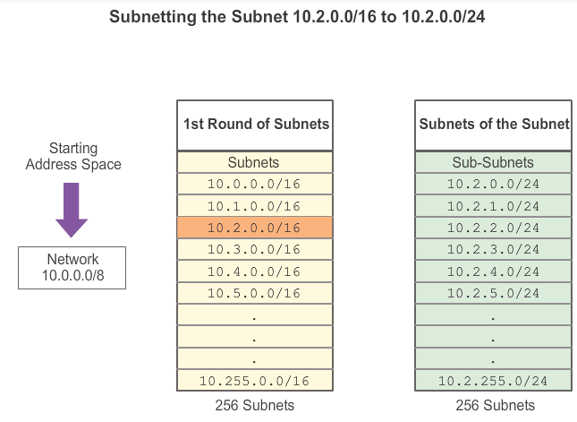
VLSM Subnetting Subnets
Notes:
6.3.3.4

Slide 42
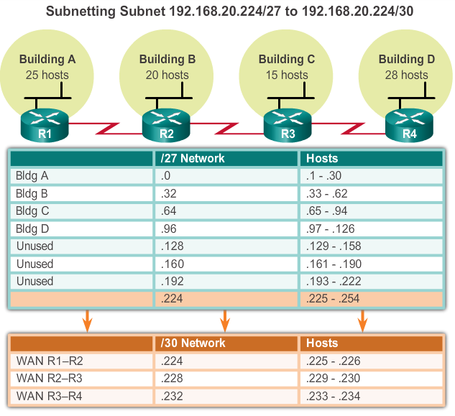
VLSM VLSM Example
Notes:
6.3.3.5

Slide 43
Configure IPv4 Summary Routes Route Summarization
Route summarization, also known as route aggregation, is the process of advertising a contiguous set of addresses as a single address with a less-specific, shorter subnet mask.
CIDR is a form of route summarization and is synonymous with the term supernetting.
CIDR ignores the limitation of classful boundaries, and allows summarization with masks that are smaller than that of the default classful mask.
This type of summarization helps reduce the number of entries in routing updates and lowers the number of entries in local routing tables.
Notes:
6.4.1.1

Slide 44
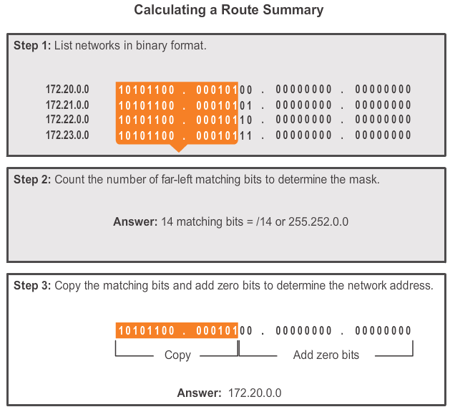
Configure IPv4 Summary Routes Calculate a Summary Route
Notes:
6.4.1.2

Slide 45
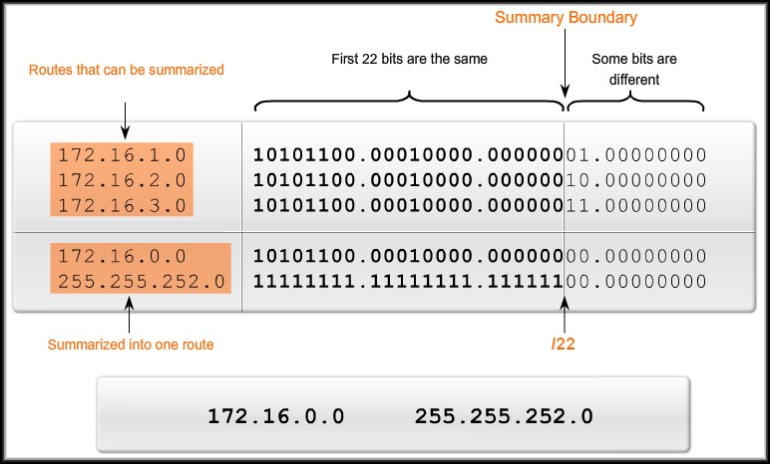
Summarizing routes Example
Write Networks in Binary Format.
Mark the Summary Boundary where bits are common.
Count left most matching bits to produce the mask (/22)
Copy the matching bits and make the remaining bits zero to the to get the summerised route.

Slide 46
Configure IPv6 Summary Routes Summarize IPv6 Network Addresses
Aside from the fact that IPv6 addresses are 128 bits long and written in hexadecimal, summarizing IPv6 addresses is actually similar to the summarization of IPv4 addresses. It just requires a few extra steps due to the abbreviated IPv6 addresses and hex conversion.
Multiple static IPv6 routes can be summarized into a single static IPv6 route if:
The destination networks are contiguous and can be summarized into a single network address.
The multiple static routes all use the same exit interface or next-hop IPv6 address.
Notes:
6.4.2.1

Slide 47
Configure IPv6 Summary Routes Calculate IPv6 Summary Network Addresses
Step 1. List the network addresses (prefixes) and identify the part where the addresses differ.
Step 2. Expand the IPv6 if it is abbreviated.
Step 3. Convert the differing section from hex to binary.
Step 4. Count the number of far left matching bits to determine the prefix-length for the summary route.
Step 5. Copy the matching bits and then add zero bits to determine the summarized network address (prefix).
Step 6. Convert the binary section back to hex.
Step 7. Append the prefix of the summary route (result of Step 4).
Notes:
6.4.2.2

Slide 48
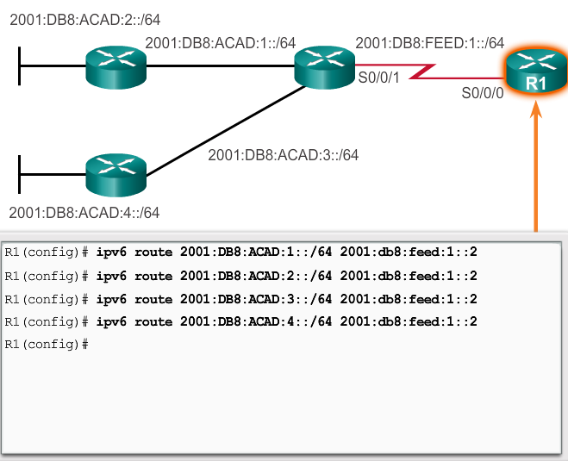
No Summary- Add 4 Static Routes

Slide 49
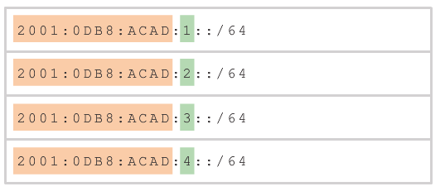
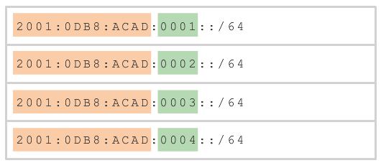
IPv6 Summary
List the network addresses
Expand the IPv6 if it is abbreviated

Slide 50
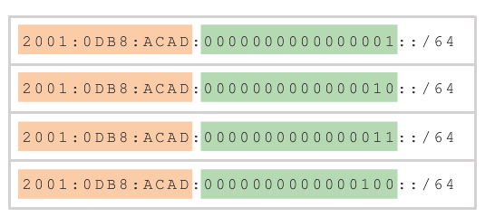
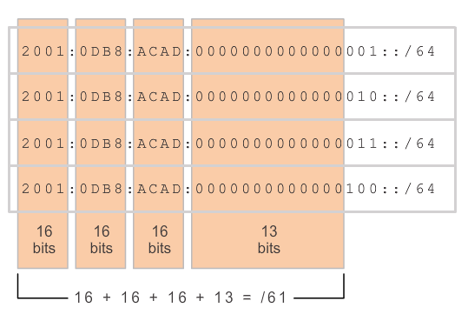
IPv6 Summary
Convert the differing section from hex to binary.
Count the number of far left matching bits

Slide 51
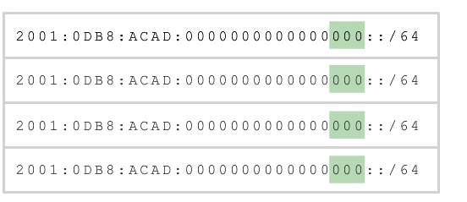
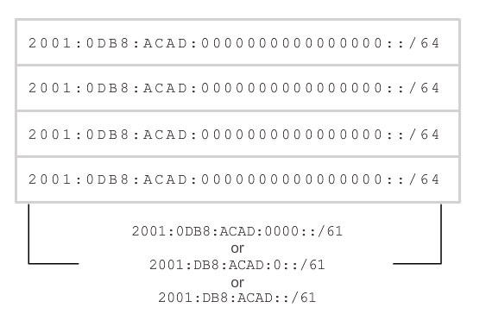
IPv6 Summary
Copy the matching bits and then add zero bits
Convert the binary section back to hex.

Slide 52
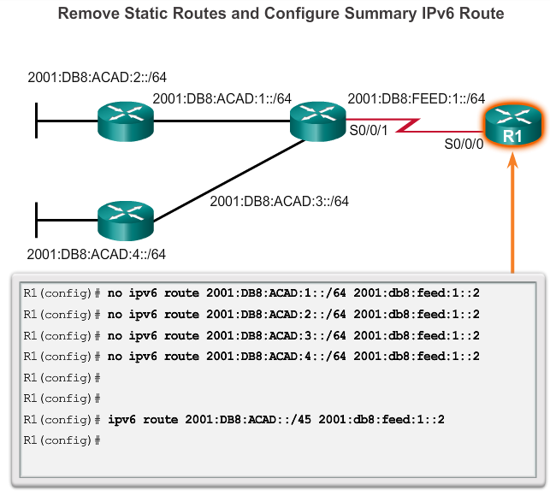
Configure IPv6 Summary Routes Configure an IPv6 Summary Address
Notes:
6.4.2.3

Slide 53
Configure Floating Static Routes Floating Static Routes
Floating static routes are static routes that have an administrative distance greater than the administrative distance of another static route or dynamic routes.
The administrative distance of a static route can be increased to make the route less desirable than that of another static route or a route learned through a dynamic routing protocol.
In this way, the static route “floats” and is not used when the route with the better administrative distance is active.
However, if the preferred route is lost, the floating static route can take over, and traffic can be sent through this alternate route.
Notes:
6.4.3.1

Slide 54
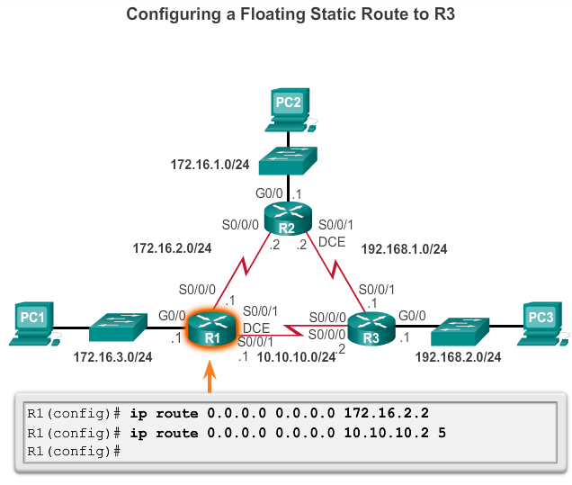
Configure Floating Static Routes Configure a Floating Static Route
R1 is configured with a default static route pointing to R2. Because no administrative distance is configured, the default value (1) is used for this static route.
R1 is also configured with a floating static default pointing to R3 with an administrative distance of 5.
This value is greater than the default value of 1 and, therefore, this route floats and is not present in the routing table, unless the preferred route fails.
Notes:
6.4.3.2

Slide 55
Configure Floating Static Routes Test the Floating Static Route
Use a show ip route command to verify that the routing table is using the default static route.
Use a traceroute command to follow the traffic flow out the primary route.
Disconnect the primary link or shutdown the primary exit interface.
Use a show ip route command to verify that the routing table is using the floating static route.
Use a traceroute command to follow the traffic flow out the backup route.
Notes:
6.4.3.3

Slide 56
Troubleshoot IPv4 Static and Default Route Configuration Troubleshoot a Missing Route
Common IOS troubleshooting commands include:
ping
traceroute
show ip route
show ip interface brief
show cdp neighbors detail
Notes:
6.5.2.1

Slide 57


